Slide 1
Project #3
Sheena Takkenberg

Slide 2
The Projects
(Yes, projects, plural)

Slide 3
Tilt
Take Home Challenge

Slide 4
Design walkthrough

Slide 5
Design Walkthrough
What’s my project?
What’s the problem?
Wireframe
Conversation with client

Slide 6
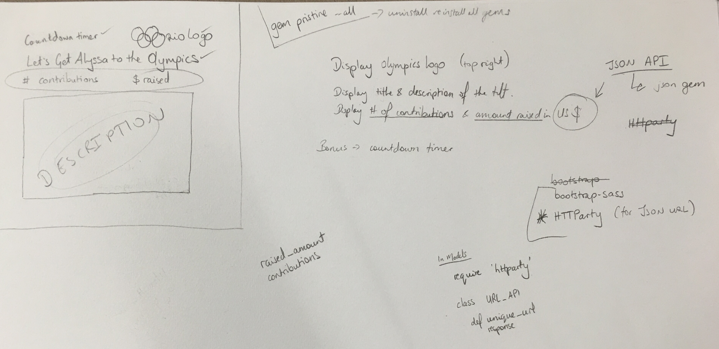
WIREFRAME & NOTES

Slide 7
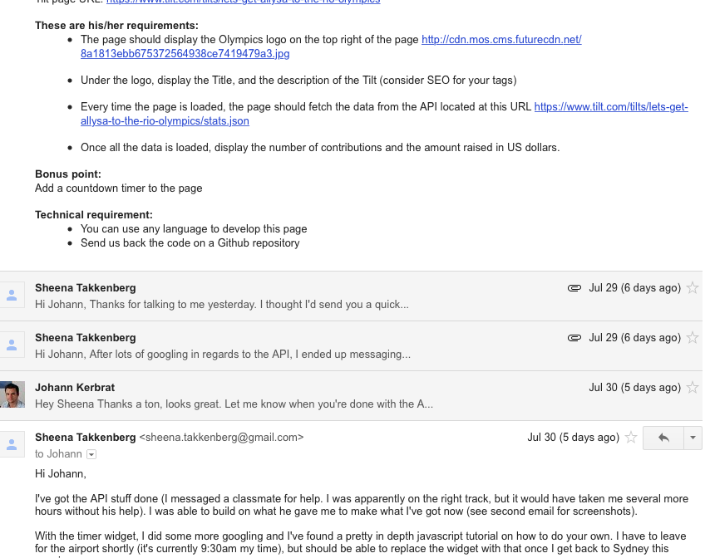
CONVERSATION WITH CLIENT

Slide 8
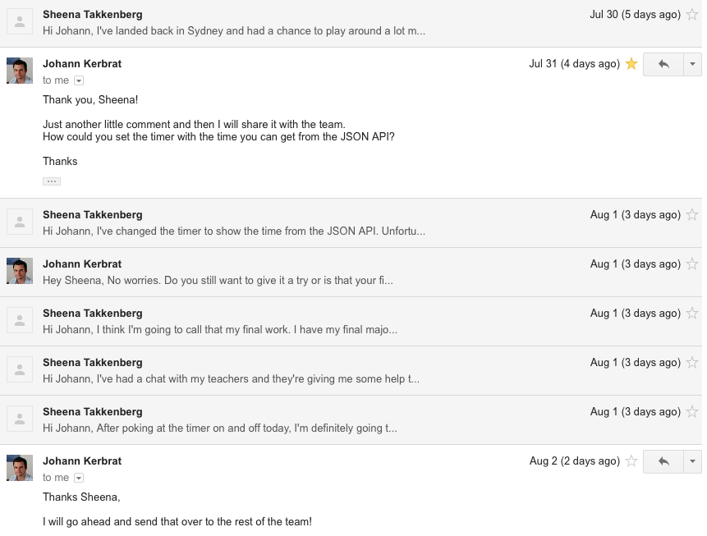
CONVERSATION WITH CLIENT

Slide 9
Review of the Build Process
Tilt

Slide 10
Review of the Build Process
Coding challenges
JSON (>.<)
The Timer
Time Zone
Favourite parts
Getting it to actually work (mostly)

Slide 11
App Walkthrough
It’s on Heroku

Slide 12
CoderFactory
Student Job Board

Slide 13
Design walkthrough

Slide 14
Design Walkthrough
What’s the project?
Job board for students
Wireframes & Notes

Slide 15
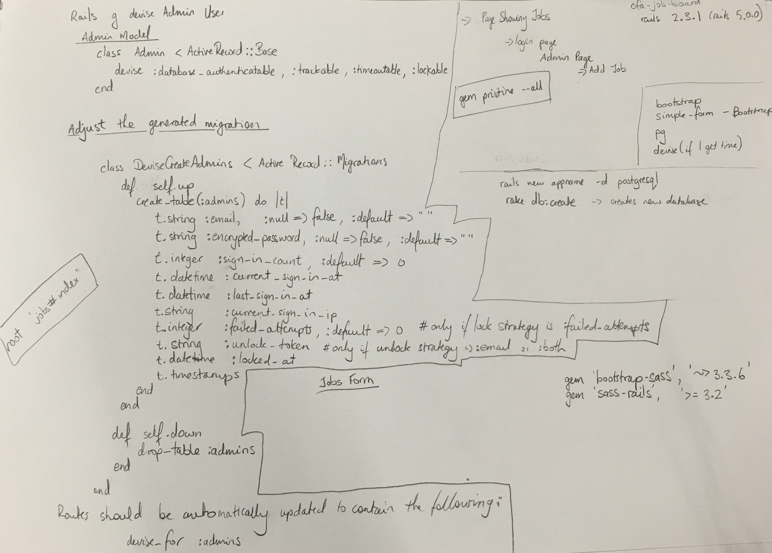
GENERAL NOTES

Slide 16
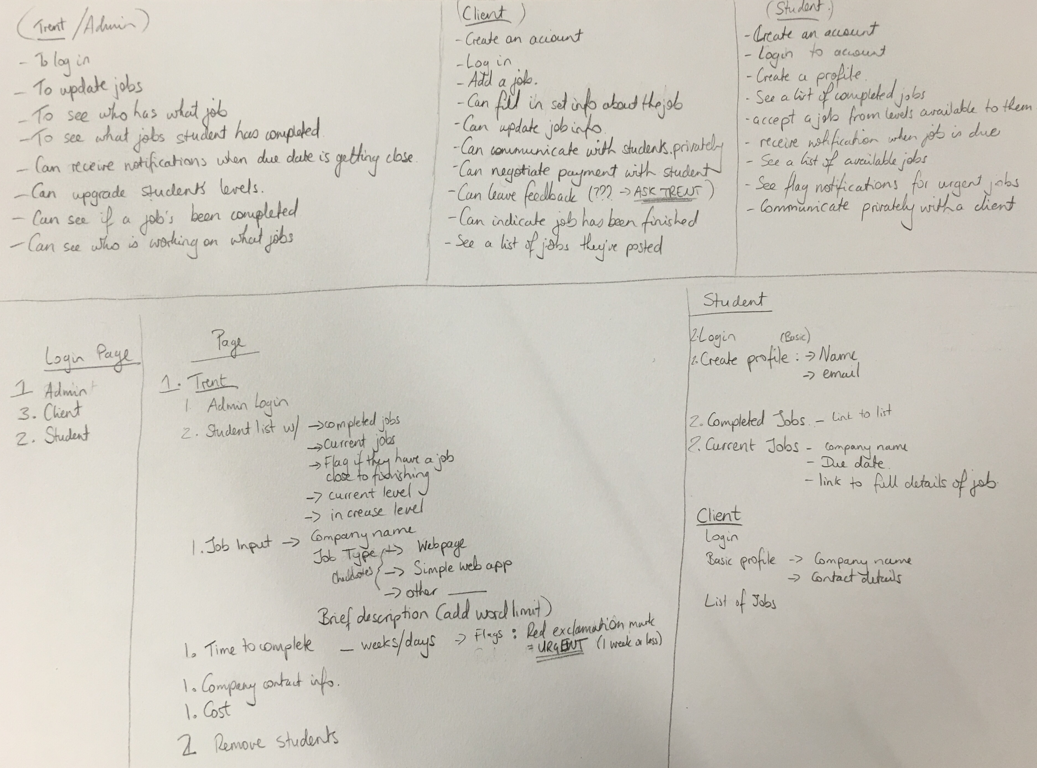
USER STORIES & NOTES

Slide 17
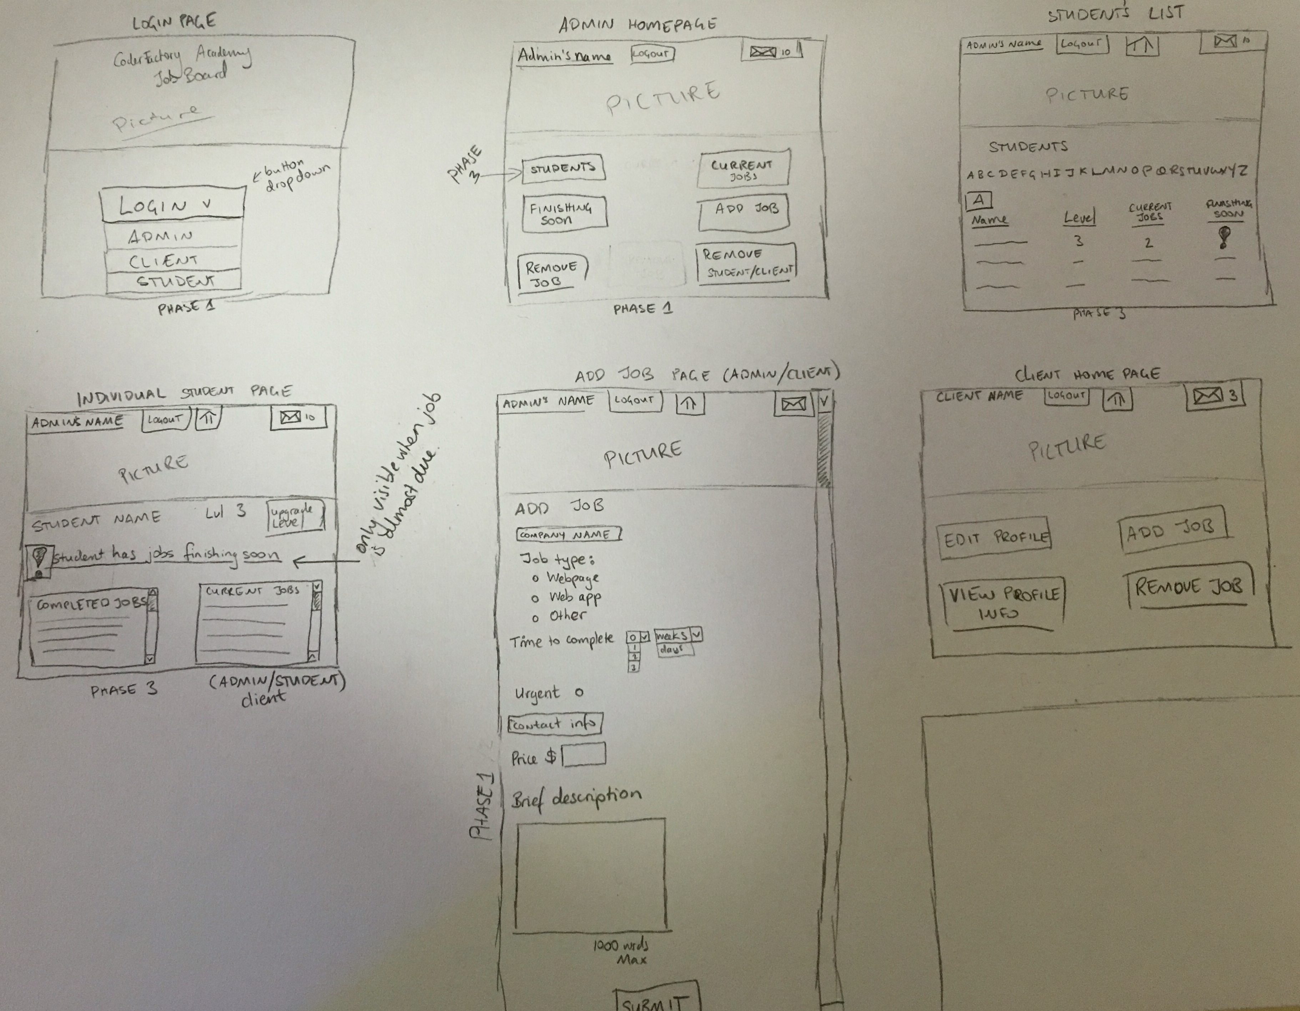
WIREFRAMES

Slide 18
REVIEW OF THE BUILD PROCESS

Slide 19
REVIEW OF THE BUILD PROCESS
Coding Challenges
RAILS BROKE!!!!
Dates
Favourite parts
Getting the dates to show
Design

Slide 20
App Walkthrough

